Slide 1


Department of Computer Engineering
Main Presentation
Under
Technical Seminar( 7CS7-40)
Session-2023-24(Odd)
Presented by
Student Name: ISHU Kumar
Registration No.: PIET20CS080
Section: 7CS-B
Presented to
Faculty Name: Saloni Jain

Slide 2
Content to be delivered :
Technical Seminar Title
Details About Guide
Objectives
Problem Identification and Definition
Proposed Methodology
Conclusion
References

Slide 3
Technical Seminar Title
Technical Seminar Title : Review of Sentimental Analysis: Machine Learning and Deep Learning Advancements

Slide 4
GUIDE:
Guide Name: Dr. Madhav Sharma Designation: Associate Professor
Student Name: Ishu Kumar Registration No.: PIET20CS080

Slide 5
Objective:
The primary objective of a review paper on Sentiment Analysis is to provide a comprehensive and critical overview of the state-of-the-art in sentiment analysis research and applications within a specific domain or across multiple domains. The objective of a review paper on sentiment analysis is to serve as a valuable resource for researchers, students, and professionals.

Slide 6
Problem Identification and Definition
Sarcasm Detection: Sarcasm detection can be enhanced by integrating contextual analysis into SA models. Leveraging sentiment lexicons and training models to understand the context in which sarcasm occurs can improve detection accuracy.
Handling Emotions: To handle a wide range of emotions, models can be trained on more diverse emotional datasets. Fine-grained emotion analysis can be implemented by creating multi-class sentiment categories representing various emotional states.
Neutral Sentiments: To address the oversight of neutral sentiments, models should incorporate a "neutral" category as a part of the classification. This ensures that reviews with no strong sentiment are correctly categorized.

Slide 7
Data Source Uncertainty: The absence of transparent data collection methods in sentiment analysis studies raises concerns about data quality and representativeness. Transparent sources are crucial for reliable, unbiased model training and generalizability.
Overfitting: Addressing overfitting can be done through techniques such as data augmentation, early stopping, and cross-validation to ensure models generalize well to unseen data.
Data Imbalance: Techniques for handling class imbalance, such as oversampling the minority class or using modified evaluation metrics, can mitigate the impact of imbalanced datasets.

Slide 8
Model Interpretability: For enhanced model interpretability, techniques like LIME (Local Interpretable Model-agnostic Explanations) and SHAP (SHapley Additive exPlanations) can be employed to provide insights into model decision-making processes.

Slide 9
Methodology
1. Data Collection:
Data acquisition and curation are vital for sentiment analysis. Sources like social media posts and customer reviews undergo preprocessing, involving tokenization, stop-word removal, and stemming/lemmatization for effective analysis.
2. Feature Engineering:
Feature selection impacts sentiment analysis models. Options include Bag-of-Words, TF-IDF, word embeddings, and BERT, with special relevance for deep learning models using contextual embeddings.

Slide 10
3. Machine Learning Models:
The review explores machine learning algorithms for sentiment analysis, spanning Naive Bayes, Decision Trees, Support Vector Machines, and ensemble methods. These models classify sentiments based on labeled data into positive, negative, or neutral categories.
4. Deep Learning Models:
Deep learning models are essential in sentiment analysis, utilizing Convolutional Neural Networks (CNNs), Recurrent Neural Networks (RNNs), and Long Short-Term Memory (LSTM) networks. Pre-processing and word embeddings (Word2Vec, GloVe) are also examined.

Slide 11
5. Evaluation Metrics:
The paper stresses the significance of evaluation metrics in sentiment analysis, discussing common metrics like accuracy, precision, recall, and F1-score. It highlights the need to choose suitable metrics based on specific applications.

Slide 12
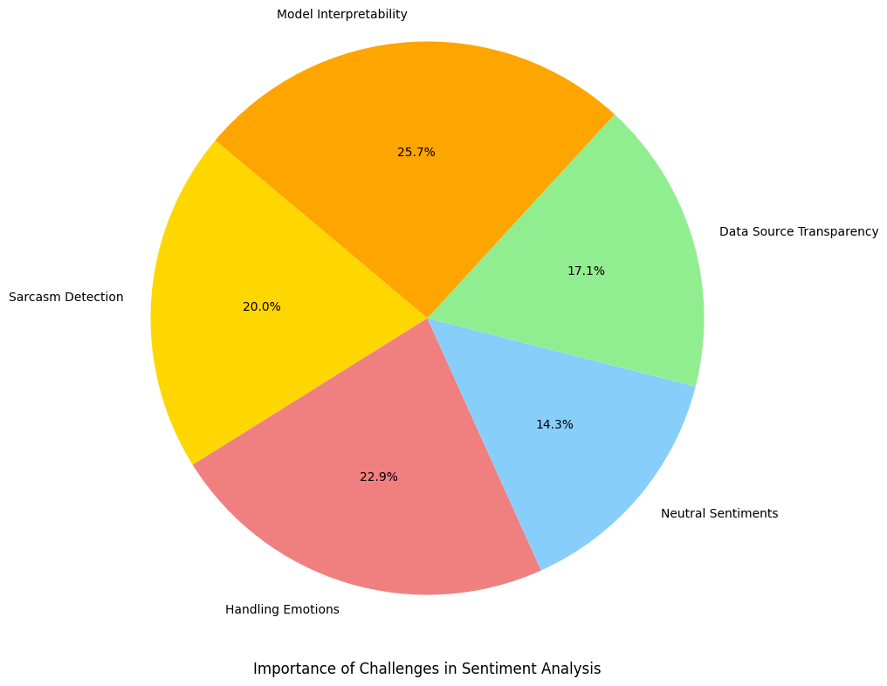
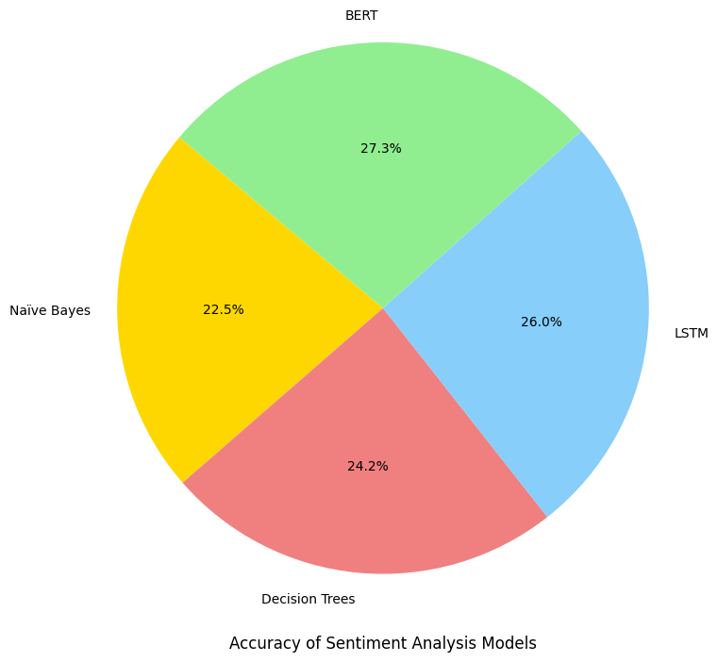
Result
This is the graphical presentation of the Accuracy of the SA models
This is the graphical presentation of the challenges of SA.

Slide 13
Sarcasm detection is a notable challenge, relying on contextual analysis for improved accuracy. Its importance in SA is 20.0%.
Handling a broad spectrum of emotions requires diverse datasets and fine-grained analysis. Its importance in SA is 22.9%.
Addressing neutral sentiments and ensuring data source transparency are important for unbiased analysis. Its importance in SA is 14.3%.
Overfitting, data imbalance, and model interpretability are critical considerations for robust sentiment models. Its importance in SA is 25.7%.

Slide 14
Conclusion
Sentiment analysis has evolved significantly with machine learning and deep learning, offering valuable insights across industries.
Challenges include sarcasm detection, fine-grained emotion analysis, neutral sentiments, data source transparency, and model interpretability.
The review is a crucial resource for researchers and practitioners, emphasizing the importance of SA in data-driven decision-making.
It outlines future research areas and challenges, guiding the development of SA in the AI landscape.
SA holds substantial potential and will continue to shape AI in the dynamic future.

Slide 15
References
Sneha Choudhary and Charu Chhabra, “Sentiment Analysis of Amazon Food Review Data” 2021 Fourth International Conference on Computational Intelligence and Communication Technologies (CCICT) | 978-1-6654-2392-2/21/$31.00 ©2021 IEEE | DOI: 10.1109/CCICT53244.2021.00033.
Sumit Sindhu, Dr. Sanjeev Kumar and Dr. Amandeep Noliya, “A Review on Sentiment Analysis using Machine Learning”, 2023 International Conference on Innovative Data Communication Technologies and Application (ICIDCA) | 979-8-3503-9720-8/23/$31.00 ©2023 IEEE | DOI: 10.1109/ICIDCA56705.2023.10099665
Chirag lala and Pulkit Dwivedi, “Hate Speech Detection Network Using LSTM, ” in Sentiment Analysis, 2023 International Conference for Advancement in Technology (ICONAT) | 978-1-6654-7517-4/23/$31.00 ©2023 IEEE | DOI: 10.1109/ICONAT57137.2023.10080786
Shubham V. Pandey and A. V. Deorankar, “A Study of Sentiment Analysis Task and It's Challenges,” UTC from IEEE Xplore 978-1-5386-8158-9/19/$31.00©2019IEEE.
Dr. S. Sangeetha, Dr. A. Latha and Mukesh D., “Sentimental Analysis Of CBDC Tweets Using Machine Learning and Deep Learning Techniques,” 2023 2nd International Conference on Advancements in Electrical, Electronics, Communication, Computing and Automation (ICAECA) | 979-8-3503-0681-1/23/$31.00 ©2023 IEEE | DOI: 10.1109/ICAECA56562.2023.10199561
Aliza Sarlan, Chayanit Nadam, Shuib Basri, “Twitter Sentiment Analysis,” 2014 International Conference on Information Technology and Multimedia (ICIMU), November 18 – 20, 2014, Putrajaya, Malaysia
Ziqi Zhang, Lie Luo , “Hate speech detection: A solved problem? The challenging case of long tail on Twitter,” Semantic Web, vol. 10, no. 5, pp. 925–945, Sep. 2019
Kshirsagar, Rohan & Cukuvac, Tyrus & McKeown, Kathy & McGregor, Susan. (2018). Predictive Embeddings for Hate Speech Detection on Twitter. 26-32. 10.18653/v1/W18-5104.
Pinkesh Badjatiya,Shashank Gupta,Manish Gupta,Vasudeva Varma, ”Deep Learning For Hate Speech Detection in Tweets” in 26th International World Wide Web Conference, perth, Australia, 2017
Robinson, David, Ziqi Zhang and Jonathan A. Tepper. Hate Speech Detection on Twitter: Feature Engineering v.s. Feature Selection ESWC (2018)

Slide 16
Thanks
&
Query

